Slide 1

Git Basics
A simple “in-branch” presentation/workshop
Nikolas Kostakis

Slide 2
What is Git

Slide 3
What is Git
Git is a distributed version-control system for tracking changes in source code during software development. It is designed for coordinating work among programmers, but it can be used to track changes in any set of files. Its goals include speed, data integrity, and support for distributed, non-linear workflows.

Slide 4
What is Git
Your best friend for every project!
Git is a distributed version-control system for tracking changes in source code during software development. It is designed for coordinating work among programmers, but it can be used to track changes in any set of files. Its goals include speed, data integrity, and support for distributed, non-linear workflows.

Slide 5
What can I do with git
Keep track of all the changes to your file
No more final.c, finalfinal.c, final25.c etc.
Split the work between two or more people without having all of them changing the same file
More on that later…

Slide 6
Install git

Slide 7

Install git on Linux
To install git on linux, open a terminal and write the following command:
sudo <your_package_manager> install git
Your package manager is different based on your distro:
apt or apt-get for Ubuntu
yum for Fedora
packman for Arch Linux
etc.

Slide 8

Install git on Windows
To install git on Windows, go to the following linl:
https://git-scm.com/download/win
If you have enabled the Developer Tools, you can install a linux terminal and follow the corresponding step.

Slide 9

Install git on Mac
To install git on macOS, there are two routs to follow:
Open a terminal and type:
git –-version and follow the instructions
Go to the following link and download the installer:
https://git-scm.com/download/mac

Slide 10
Repository

Slide 11
Repository
Repository is the designation of the git “project”
A repository can be local or remote.
An example of a remote repository that we are going to use in this demo is the following:
https://github.com/nikolaskostakis/Git_Test_Repo

Slide 12
.gitignore file
.gitignore is used in cases where you do not want to save a file to the repository.
In code development cases .gitignore is a very important tool, since it helps you for storing useless temporary files.

Slide 13
Basic Commands

Slide 14
Basic Commands
git init
git config
git clone
git fetch
git pull
git add
git status
git commit
git log
git branch
git checkout

Slide 15
git init
Creates an empty Git repository or reinitializes an existing one.
The repository is in a folder .git on your working folder.

Slide 16
git config
Get and set repository or global options.
The most common configurations are the following:
git config --global user.name “User“
git config --global user.email user@example.com
git config user.name “User“
git config user.email user@example.com
--global refers to global settings and not on this particular repository.

Slide 17
git clone
Clone a repository into a new directory.
For this tutorial we will use the following repo, so type this command:
git clone https://github.com/nikolaskostakis/Git_Test_Repo

Slide 18
git fetch
Download objects and refs from another repository.
This command is used when you have the repository in a remote location and you want to now if there were any changes to it.

Slide 19

git pull
Fetch from and integrate with another repository or a local branch.
This command also is used when you have the repository in a remote location and you want to pull the repository or changes on it.

Slide 20
git add
Add file contents to the index.
In this point it is good to talk how git works. Git keeps a track of the files into a staging area before storing them. This staging is done with this command.

Slide 21
git status
Show the working tree status.
With this command you keep in track the changed files as well as the staged ones.

Slide 22
git commit
Record changes to the repository. In the commit, a description must always be attached.
After staging the modified files, you have to store/record the changes/additions on them.
In the tutorial, we show you the command with the flag –m. This flag is used for cases when the attached description is small. If it not used, the default text editor will open for you to write your description.

Slide 23
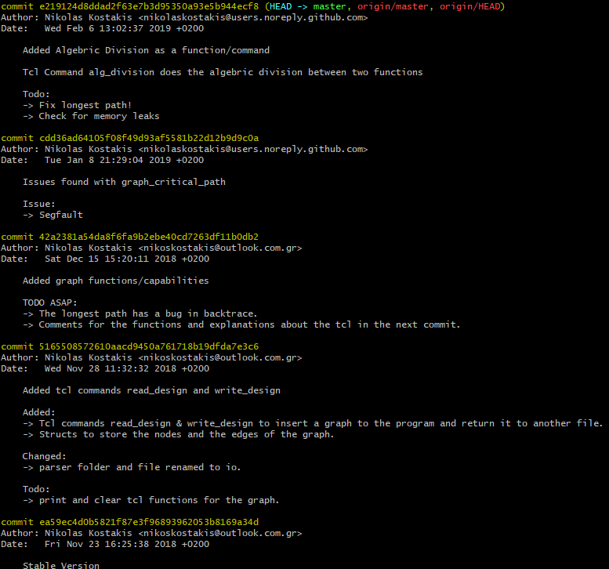
git log
Show commit logs.

Slide 24
git branch
List, create, or delete branches.
Branches are your way of having multiple development roads without colliding code changes

Slide 25
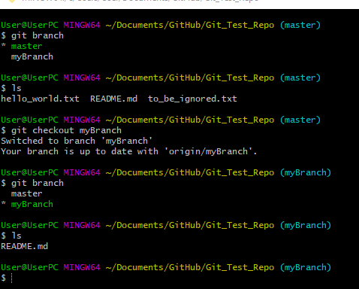
git checkout
Switch branches or restore working tree files.

Slide 26
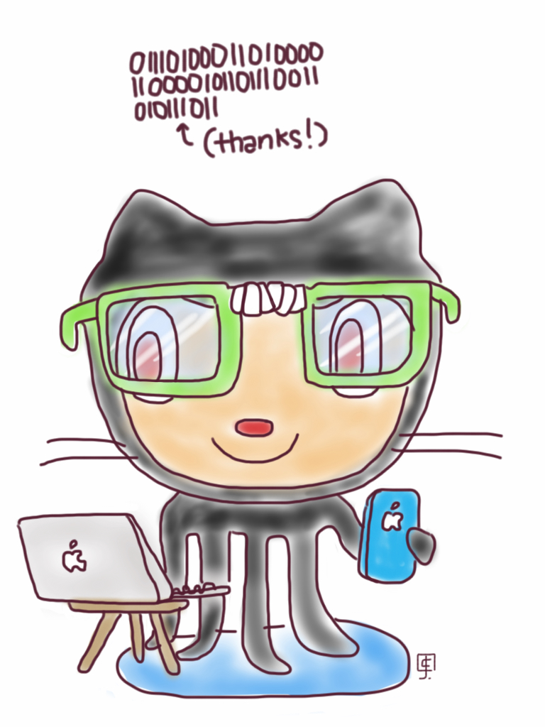
Thanks for your time!

